Slide 1
News Article Summarization Design
By: Thomas Lazarus

Slide 2
Already Done
Web Scraper
Docker Containers
Baseline model

Slide 3
Still Need Done
Model needs to be made more efficient
Front end needs polishing
mySQL database implementation
This is to track user emails if a daily newsletter gets implemented

Slide 4
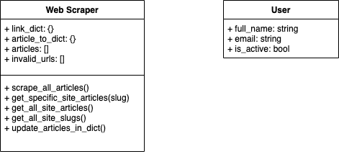
Classes

Slide 5
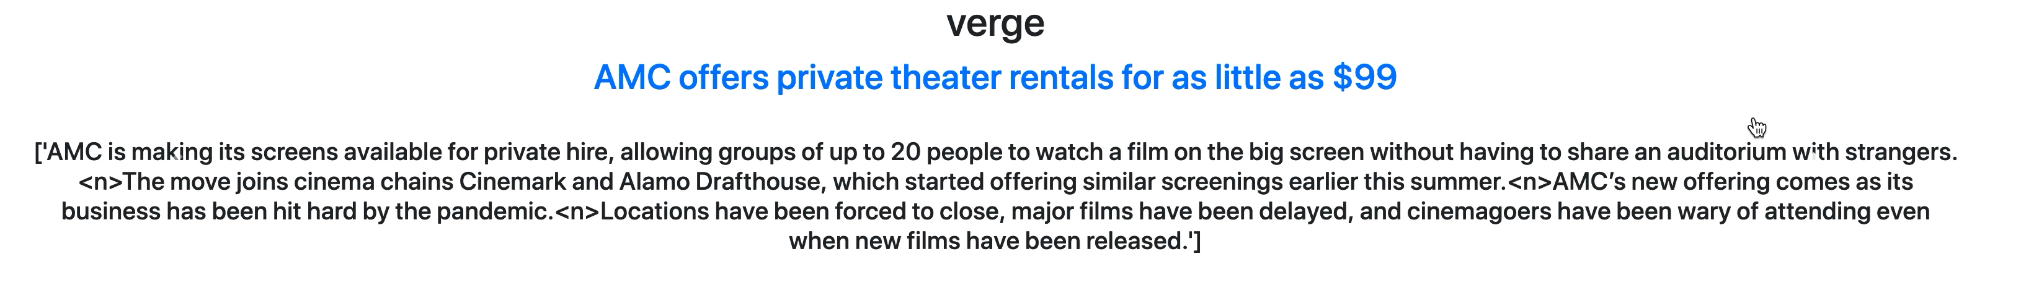
Quick View of Front end

Slide 6
Future Problems
Making Summarization Efficient
Currently it takes 30 seconds to a minute to summarize each article
Working on parallelizing it
Finishing Front end to handle multiple news sites

Slide 7
QUESTIONS?

